Slide 1
Echonlabs Pvt Ltd
UGC MIS Batch 8
Business Policy and Strategy
Group Assignment

Slide 2

Company Background

Slide 3
Vision
“Connect everyone to solutions that increase productivity and efficiency, through innovative solutions.”

Slide 4
Mission
“Provide low-cost premium solutions for businesses to build their online presence and to improve their workflow.”

Slide 5
Organizational values
Employee empowerment
Inspiring employees while giving freedom and authority to adapt and respond in real-time with solutions to deliver extraordinary results.
Knowledge sharing
Transformation of collective individual knowledge to organizational knowledge without the existence of orphaned knowledge and knowledge depreciation to result in the enrichment of organizational effectiveness.
Trust
Developing meaningful relationships to achieve tangible and intangible benefits to the organization.
Respect
Thinking Green, honour diversity and treat everyone with dignity in order to achieve growth and profitability.

Slide 6
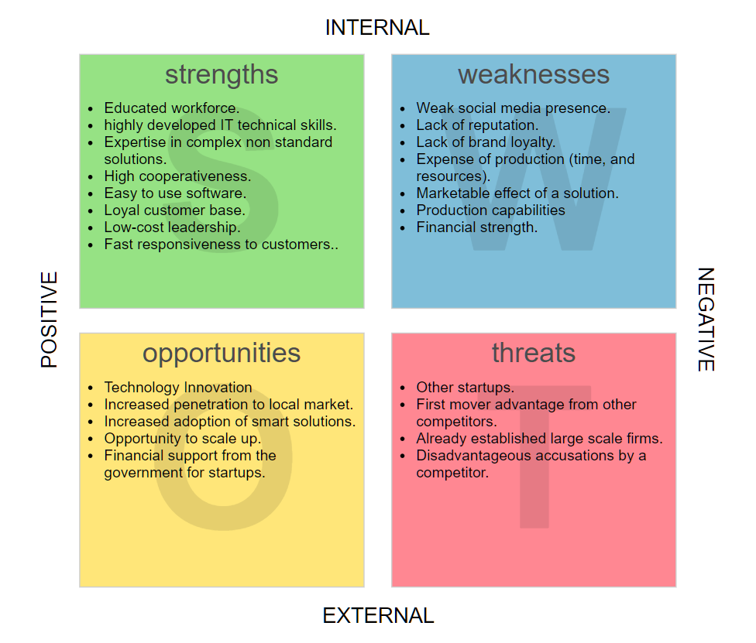
SWOT Analysis

Slide 7
SWOT Analysis
Strengths
Educated workforce.
highly developed IT technical skills.
Expertise in complex non standard solutions.
High cooperativeness.
Easy to use software.
Loyal customer base.
Low-cost leadership.
Fast responsiveness to customers.
Weaknesses
Weak social media presence.
Lack of reputation.
Lack of brand loyalty.
Expense of production (time, and resources).
Marketable effect of a solution.
Production capabilities
Financial strength.

Slide 8
SWOT Analysis
Opportunities
Technology Innovation
Increased penetration to local market.
Increased adoption of smart solutions.
Opportunity to scale up.
Financial support from the government for startups.
Threats
Other startups.
First mover advantage from other competitors.
Already established large scale firms.
Disadvantageous accusations by a competitor.

